Slide 1
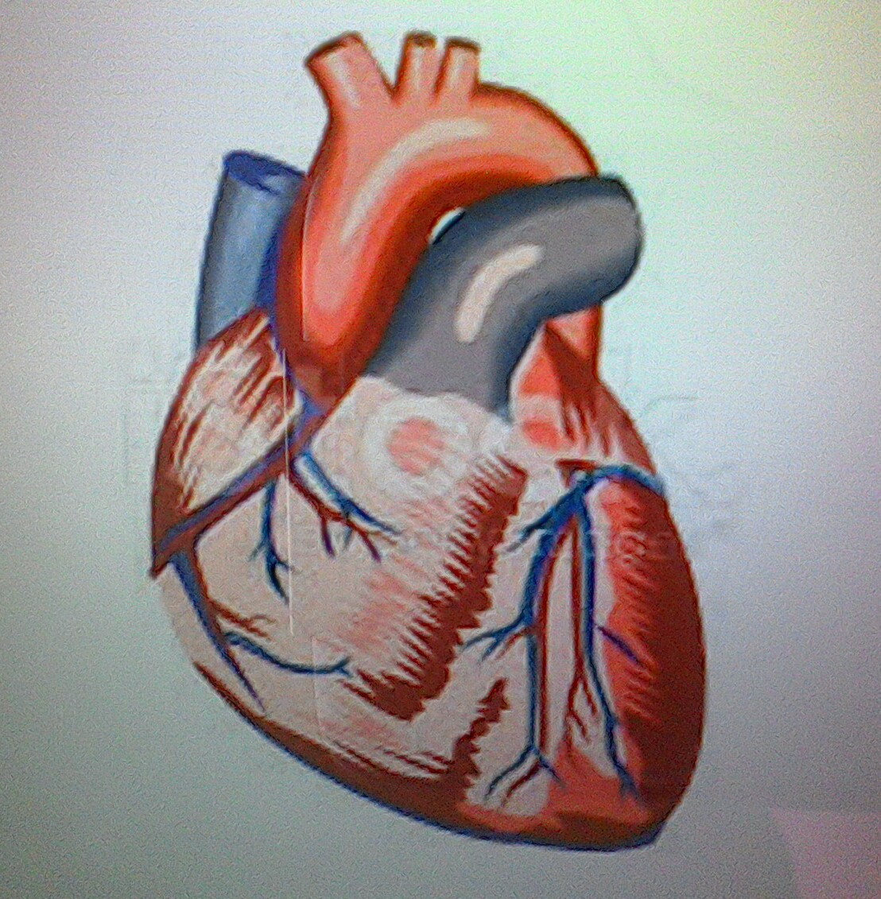
Cardiac Inotropes
By Dr.Laly

Slide 2
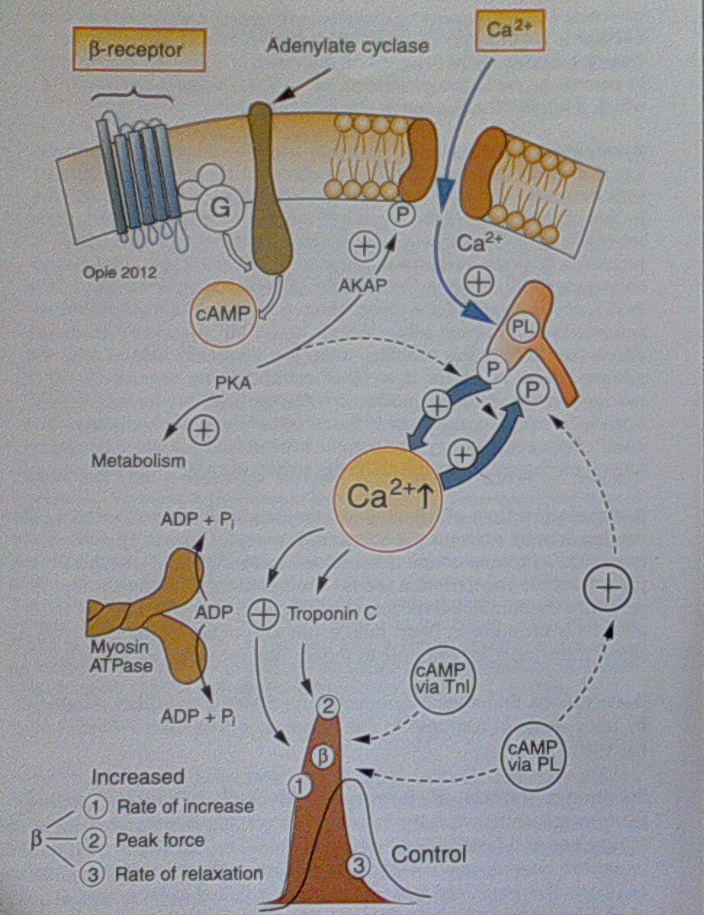
Contraction relaxation

Slide 3
Inotrope
A drug that alters the force or energy of contraction
Greek origin-ino=fibre,tropic=related to
Positive inotrope=increases myocardial contractility
Cardiac contractile failure (heart failure)
(Cardiomyopathy,acute myocardial infarction,myocarditis,cardiogenic shock,septic shock)

Slide 4
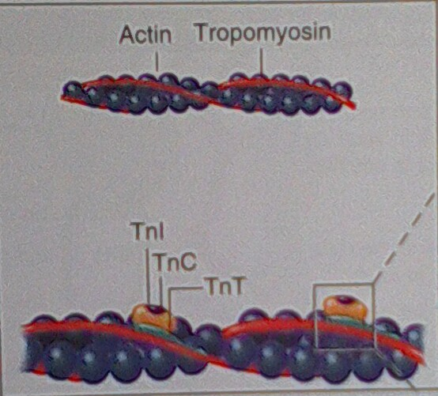
Inotrope=no of cross_bridges activated
Amount of ca available to bind troponin c
Can affinity of troponin c
Alternation at the level of cross bridging=promotion of cross bridges state, cross bridges force production, duration of cross bridges state

Slide 5
Classification
Rapid rise in c Amp
1.exogenous catecholamines
2.inhibition of breakdown of camp
PDE 3 inhibitors
•Affecting sarcolemmal pump/channel_digoxin
•Modulate intracellular Ca mechanism
•Multiple mechanism_pimobendan,vesnarinone

Slide 6
Clinical applications of inotropes
Cardiogenic shock _SBP <90
AHFS without shock with evidence of organ hypoperfusion
Intermittent outpatient infusion
Bridge until transplanation
Destination therapy for end-of-life care
Cardiopulmonary resuscitation
CHF routine therapy

Slide 7
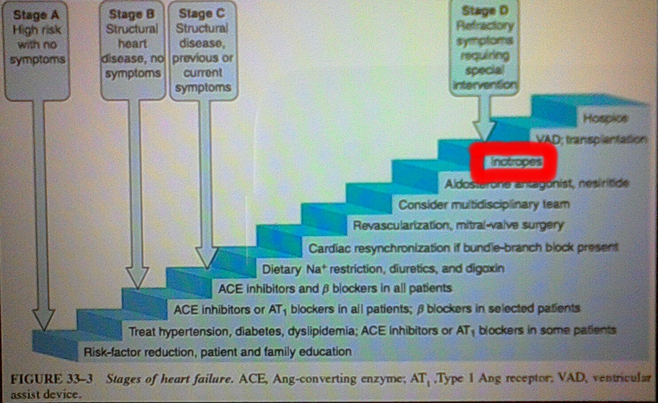
At what WHO stage to start?

Slide 8
Heterogeneity of ADHF:Management Principles
• Acute Decompensation"Typical"
Acute Decompensation"Pulmonary
Acute decompensations"Low output"
•Decompensations"Cardiogenic shock"

Slide 9
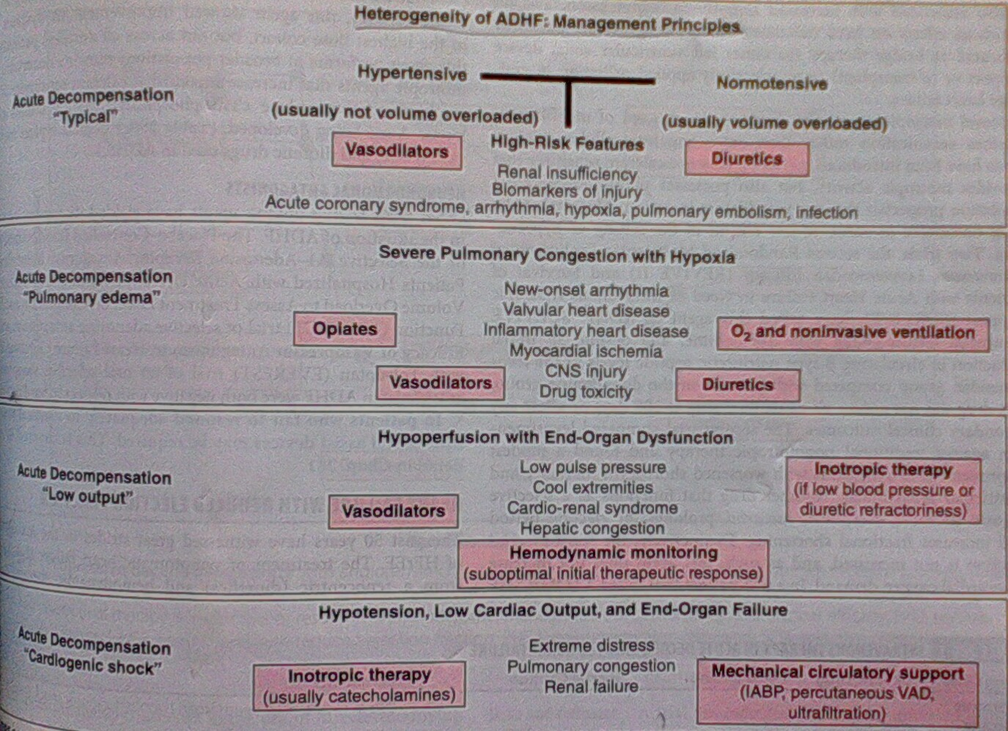

Slide 10
BETA ADRENERGIC AGONISTS
DOBUTAMINE
DOPAMINE
ISOPRENALINE
NORADRENALINE

Slide 11
Beta Adrenergic agonists -DOBUTAMINE
Directly stimulate β receptors
β1 >>>β2>>α1 (β1: β2 = 3:1)
Developed by Eli Lilly company as a structural analogue of isoprenaline in 1975
Potent inotrope , mild chronotropic and peripheral vascular effects

Slide 12
Dobutamine-Pharmacology
Onset of action: 1-2 mins
Peak effect : ~ 10 mins
Half-life : 1-2mins
Metabolism : Methylation & conjugation --- Urine
250mg/20 ml vials
2-20micg/kg/min( max 40micg/kg/min¹)
Sodabicarb should not be given in the same i.v line (inctivation at alkaline pH)

Slide 13
Dobutamine- Clinical application
Mild vasodilation : <5micg/kg/min
(At higher doses >15, peripheral effect becomes vasoconstriction)
Used mainly for primary low COP states
Better not used as single inotrope for cardiogenic shock
Dose titration required due to variable sensitivity (especially elderly)
? Loss of efficacy in patients on chronic beta blocker therapy/acidosis/hypoxia

Slide 14
Dobutamine –Side effects
Hypotension
Hypertension and Tachycardia – especially for those with chronic beta blocker therapy
AF with increased ventricular rate
Ventricular arhhythmias (rare)
Worsening ischemia
Phlebitis (rarely)
Nausea, headache, chest discomfort, hypokalemia, hypersensitivity (eosinophilic myocarditis)
No significant drug interactions
Contraindicated in HCM

Slide 15
Dobutamine – Evidence base
Experience from controlled trials do not extend beyond 48 hours
Found superior to isoproterenol for increasing COP¹
( A comparison of dopamine, dobutamine and isoproterenol in the treatment of shock. Intensive Care Med.1985;11(1):13-9)
Found equivalent to Dopamine in increasing COP however at lower peak heart rates and LVEDP²
(Comparison of dobutamine and dopamine in treatment of severe heart failure. Br Heart J. 1977 May; 39(5): 536–539.)
Dobutamine has no survival benefit and may even increase mortality in severe heart failure³
(Dobutamine for patients with severe heart failure: a systematic review and meta-analysis of randomised controlled trials. Intensive Care Med. 2012 Mar;38(3):359-67)

Slide 16
Dopamine- Pharmacology
Low dose (0.5-2µg/kg/min): (Vasodilation)
D1 post-syn receptors -- Cor, ren, mes, cereb
D2 presyn receptors – Renal tissue and vasculature
Intermediate dose (2-10 µg/kg/min): (Inotropic)
β 1 receptors of heart
High dose (10-20 µg/kg/min) : (Vasoconstriction)
α 1 receptors of vessels
200-400mg/5ml vial
Onset of action – 5 mins
T-half – 2 mins
Primarily renal excretion

Slide 17
Dopamine- Evidence
PRIME-II study (Ibopamine) : Increased mortality in heart failure.
(Hampton et al. Randomised study of effect of ibopamine on survival in patients with advanced severe heart failure. (PRIME II). Lancet. 1997; 349: 971–977.)
Enthusiasm of low dose Dopamine and renal vasodilation -
(-Goldberg et al. Cardiovascular and renal actions of dopamine. Pharmacol Rev. 1972;183: 256–263.)
Wide variations in dose-dependent renal effects, esp when associated with renal disease/septic shock, and no clinically relevant renal benefits.
(-Wee et al. Effect of intravenous infusion of low-dose dopamine on renal function in normal individuals and in patients with renal disease. Am J Nephrol. 1986, 6: 42–46.
- Girbes et al. Lack of specific renal haemodynamic effects of different doses of dopamine after infrarenal aortic surgery. Br J Anaesth. 1996; 77: 753–757.)
However clinical benefit in improving renal function has been reported when used along with diuretics for congestive heart failure
(Varriale. Role of dopamine in congestive heart failure: a contemporary appraisal. Congest Heart Fail. 1999 May-Jun;5(3):120-124.)
- Elkayam et al. Renal Vasodilatory Action of Dopamine in Patients With Heart Failure. Circulation.2008; 117: 200-205 )

Slide 18
Dopamine – Guidelines for HF
In patients with shock, despite already treatment with an inotrope
ESC 2012 -- IIb, C
- ACC/AHA 2009 -- IIb, C

Slide 19
Beta adrenergics- ISOPROTERENOL
Potent nonselective pure β agonist
Powerful chronotrope, inotrope and peripheral vasodilator
Net neutral impact on COP.
Used clinically as a positive chronotrope rather than as an inotrope.
Not used for cardiogenic (pump-failure) shock management

Slide 20
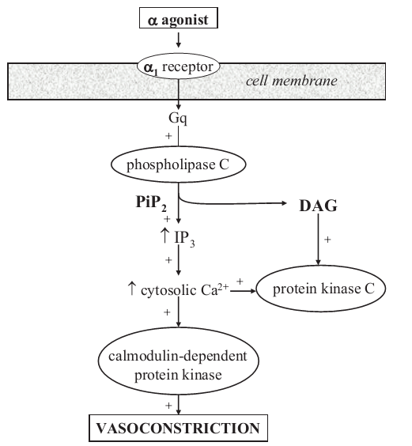
NOREPINEPHRINE
α1>>β1> β2
Powerful vasopressor, modest inotropic effects
Less chronotropic effect than Dob and Dop

Slide 21
Norepinephrine – Clinical applications
In general, better studied and applied for septic shock than cardiogenic shock
Cardiotoxic at high doses due to apoptosis in experimental models
( PKA mediated)
--Side effect profile similar to Dopamine

Slide 22
Dopamine vs Norepinephrine
Shock due to any cause – NE = Dop
(Cochrane review , May 11 2011)
Septic shock – NE > Dop
No significant mortality difference, Greater adverse effects due to Dopamine.
(N Engl J Med. 2010 Mar 4;362(9):779-89)
Mortality higher for dopamine
( 1) J Intensive Care Med. 2012 May-Jun;27(3):172-8
2) Crit Care Med 2012; 40:725–730)
Cardiogenic shock – NE > Dop
Mortality as well as arrhythmias higher for Dopamine
(N Engl J Med. 2010 Mar 4;362(9):779-89)
AHA 2009/ESC 2012/HFSA 2010 guidelines do not comment on superiority/ priority of any single inotrope…. Dobutamine generally accepted as 1st inotrope of choice for heart failure.
Additional support with ?Dop> NE inspite of contrary evidence....AHA guidelines.

Slide 23
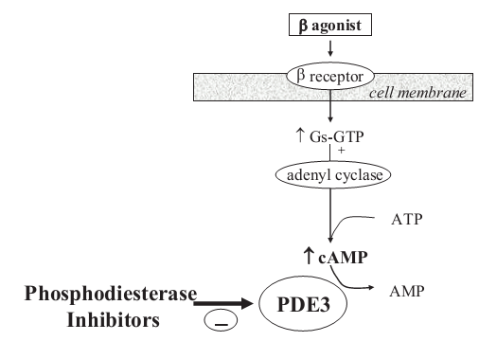
PHOSPHODIESTERASE-3 INHIBITORS (Inodilators)
MILRINONE
AMRINONE
ENOXIMONE
VESNARINONE

Slide 24
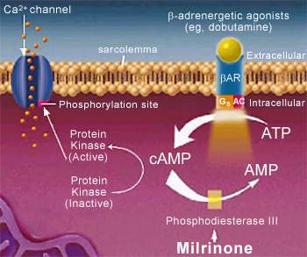
PDIs - MILRINONE
Vasodilation (cAMP inhibits MLCK in vessels) > positive inotropy
Inotropic, Chronotropic, Lusitropic
Systemic circulation effects:
- Vasodilation
- Increased organ perfusion
- Decreased systemic vascular resistance
- Decreased arterial pressure
Cardiopulmonary effects:
- Increased contractility and heart rate
- Increased stroke volume and ejection fraction
- Decreased ventricular preload
- Decreased pulmonary capillary wedge pressure

Slide 25
Milrinone - Pharmacology
Bolus: 50µg/kg bolus over 10 to 30 min (preferably avoided)
Infusion: 0.375 to 0.75µg/kg/min
(Dose adjustment required for GFR<30ml/min)
Half life : 2.5 hours
Renal clearance – prolonged action if renal dysfunction develops

Slide 26
Milrinone- Side effects
Ventricular arhythmias ~ 12% ( serious ~ 1.2%)
SVT ~3.8%
Hypotension, angina
Torsade de pointes – reports
Headaches ~ 2.9%
Hypokalemia, tremor, thrombocytopenia (rare ~ 0.4%)
Transaminitis, hypersensitivity
No significant drug interactions
Should not be injected in same line as furosemide

Slide 27
Milrinone- Clinical application
Acute heart failure
Theoretical advantages compared to β agonists :
Chronotropic effect is less than β agonists
Less tachycardia for AF patients
Better efficacy for those on chronic BB therapy
Lusitropic and vasodilatory effects ( decrease afterload and preload)
(However more expensive, hypotension and prolonged action with Milrinone)

Slide 28
Outcomes of a Prospective Trial of Intravenous Milrinone For Exacerbations of Congestive Heart Failure
Outcomes
No difference in primary end point between Milrinone and placebo.
Higher instance of atrial arrhythmia and hypotension with Milrinone.
Milrinone is associated a 30% increase in mortality

Slide 29
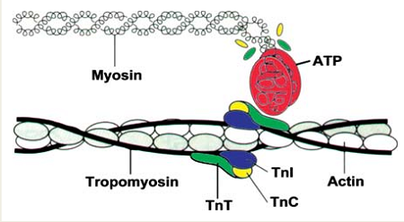
CALCIUM SENSITIZERS- LEVOSIMENDAN
Pyridazone-dinitrile derivative
Dual mechanism of action:
1) Binds to Ca binding site of TnC in sarcomere
2) K_{ATP} channel opener in smooth muscles

Slide 30
Levosimendan – Actions
Binds to Ca binding site (N-terminus) of TnC
Stabilizes the Ca-TnC complex and inhibits TnI -- prolongs actin-myosin cross bridge association rate
The binding affinity depends on the i.c Ca concentration
Hence, inotropic action only during systole (On-off action)
PDI like action at higher concentrations¹

Slide 31
Levosimendan - Pharmacology
Loading : 12-24µg/kg over 10 min
Infusion: 0.05-0.2µg/kg/min
Can be given orally also (Bioavailability ~85%)
T-half – 0.5-1.4 hours
Hepatic + intestinal metabolism (no renal modification)
Dose dependent action (linear pharmacokinetics)
Active metabolite – OR-1896 (half life of 80 hours) – responsible for prolonged action upto several days after stopping infusion

Slide 32
Levosimendan – Side effects
Hypotension (15- 50%)
Headache
Arrhythmias
No significant drug interactions

Slide 33
Levosimendan – theoretical advantages over Dobutamine
Vasodilatory action– decrease preload, after load and improves coronary blood flow.
Does not increase intracellular Ca/ oxygen demand
Does not impair diastolic relaxation (Positive lusitropy)
Decreases LVEDP during coronary ischemia
By action on mitochondrial K_{ATP} channels – decrease apoptosis– in vitro beneficial effects on remodelling.
Beneficial in CAD, sepsis, paediatric sub groups
Antioxidant and anti-inflammatory effects
Beneficial renal and gastrointestinal effects

Slide 34
Levosimendan - Evidence
Credited with the largest available evidence among iv inotropes (>3500 patients)
A 24 hour infusion increased COP ~40%, reduced PCWP
( -8.9mmHg) , 30% reduction in SVR & increased HR (~6bpm)

Slide 35
REVIVE -1 and REVIVE-2 (2005):
Severe ADHF (EF<35%)
Better study design than previous
Early improvement of symptoms over 5 days
No mortality benefit at 90 days, with higher incidence of hypotension and arrhythmias.
SURVIVE (2005):
Levosimendan vs Dobutamine for ADHF (EF<35%)
1327 patients
Significant early symptomatic benefit and improvement in hemodynamic parameters
No overall mortality benefit at 6 months
Significant 30 day mortality benefit for those with previous CHF (on c/c BB therapy)

Slide 36
LEVOSIMENDAN - Evidence
Significant mortality benefit for critically ill patients with heart failure and patients undergoing cardiac surgery
(Metanalysis from 11 controlled trials (2009) )
Improves mortality after coronary revascularisation compared to standard therapy
(Critical Care 2011)
Improves survival as well as hemodynamics compared to dobutamine
( metanalysis -- International Journal of Cardiology 2010)

Slide 37
Levosimendan cost analysis?
Cost of Levosimendan (2.5mg/5ml) ~ 10 times cost of dobutamine
However it is shown to be cost effective when compared to standard inotropic agents in acute severe low output heart failure considering re-hospitalisation rates.

Slide 38
Final word on Levosimendan?- guidelines
Only intravenous positive inotrope that has had a mortality benefit consistently.
Plenty of theoretical advantages over standard inotropes
Uniform physiological benefits for coronary, renal and g.i systems
Hypotension may be the main reason negating its efficacy
ESC: Recommended as second line inotrope (IIa,B) for AHFS
Approved in Europe, Asia, South America & Australia

Slide 39
DIGOXIN
A purified glycoside extracted from foxglove plant (Digitalis lanata)
Discovered & described by William Withering in 1785
-English botanist, geologist, chemist & physician
Initially a routine drug for ‘dropsy’ (edema)
Oldest CVS drug that is still being used (>200years)

Slide 40
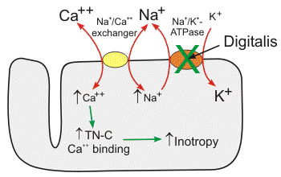
Digoxin - Action
Potent inhibitor of cellular Na-K ATP-ase -- blunts Ca extrusion
Positive inotropy ( LVEDP, LVEDV &LVESV )
Negative chronotropy and dromotropy ( vagal action)
Increased baroreceptor sensitization--withdrawal of sympathetic stimulation-- vasodilation
Decreases neurohormonal activation
Induces diuresis

Slide 41
Digoxin- Pharmacology
Oral administration
T-half = 40 hours ( So steady state in around a week)
----- Digitalization
Bioavailability : 60-80%
Onset ~ 2hours ; Peak effect ~ 2-6 hours
Better taken in empty stomach
Intestinal absorption is inhibited by P-glycoprotein on enterocytes (an efflux protein)
Large volume of distribution (500litres)
Crosses BBB and placenta
25% bound to plasma proteins
Excretion – 70-80% unchanged by renal (1st order kinetics)

Slide 42
Oral digoxin administration
Narrow therapeutic levels (0.5-1.5ng/ml)
Body weight, age, renal function
For sick patients – loading dose(rapid digitalization)
Loading dose: ~20- 45 µg/kg (paed) / 10-15 µg/kg (adults)
1/2 total dose initially--1/4 dose every 4-6 hours twice
(Presently recommended only for AF rate control)
Maintenance dose: ~10µg/kg (paed) & ~5 µg/kg (adult)
(~ 1/4th of loading dose)
~ 0.125- 0.25mg for an adult male with HF and normal renal function

Slide 43
Digoxin – i.v
Can cause systemic as well as coronary vasoconstriction (avoided by administration over 20-30mins)
When carefully used is hemodynamically beneficial for AHFS.
Effects see within an hour.
However not recommended by international guidelines due to lack of evidence.

Slide 44
Digoxin- side effects
Dose dependent
~ 5-20%
( 15-20% serious side effects)
(~ 50% is cardiac toxicity)
GI: nausea, vomiting, intestinal pain, hemorrhagic necrosis
CVS: Almost any arrythmias
CNS: blurring/yellow vision, delirium, headache, confusion, depression, hallucination
Thromobocytopenia, gynaecomastia, skin reaction

Slide 45
Digoxin effect
STD with inverted/biphasic T waves (‘Inverted tick-mark’)
QT shortening
Prominent U waves
PR prolongation
Peaking of T waves

Slide 46
Digoxin – Drug interactions

Slide 47
Digoxin toxicity
Hospitalisation for suspected toxicity in DIG ~ 2%
Dig-arrhythmia at 1.7ng/ml ~ 10% & at 2.5ng/ml ~ 50%
Caution in elderly, females, CKD, drug interaction, cardiac amyloidosis, hypothyroidism, hypokalemia, hypoxia, severe acid-base imbalances
Ideal SDC is 0.7-1.3ng/ml
SDC recommended for high risk patients ~ 14-21 days after initiation atleast 8hours after previous digoxin dose.
GI symptoms, CNS symptoms, various arhhythmias, hyperkalemia should provoke suspicion.
Stop digoxin, correction of precipitants, treatment of arhhythmias, Digibind Abs for lifethreatening arrhythmias and dialysis for hyperkalemia.

Slide 48
Dig trial
*important of measuring digoxin level
*digoxin level more than 1.2 ng per ml,Maybe harmful
*0.5 to 0.9 maybe optimal
*nutral effect on mortality
*reduction in hospitalization rate and heart failure progression
*associated with increase mortality in females

Slide 49
Summary of current inotropic interventions

Slide 50
Newer inotropic agents – Hope ?

Slide 51
ISTAROXIME
Steroidal drug, non-glycoside
Luso-inotropic agent
SERCA-2a stimulation (Lusitropism)
Na-K ATPase inhibition (Inotropism)
Improving the impaired Ca cycling of HF
- Reduced activity/expression of SERCA
- Increased activity of NCX causing Ca extrusion
- Increased inhibitory function of phospholamban on SERCA
- Upregulation of RYR2 causing Ca leak

Slide 52
Istaroxime- Evidence
Comparing istaroxime:
- With digoxin: Greater inotropic effect, better safety margin, no direct bradycardic effect
With dobutamine: Better cardiac work efficiency
Physiological effects:
- Increases SBP, does not affect DBP
Decreases PCWP
Improves CI, Decreases LVEDV and LVSV
Decreases HR
Shortens QT interval

Slide 53
Istaroxime- HORIZON-HF
Phase II dose-escalating RCT, 120 patients
Worsening HF, LV dysfunction, PCWP>20mmHg
0.5,1,1.5 µg/kg/min over 6 hours
18-25 years, EF<35%, SBP 90-150
Exclusion: AF, ACS, LBBB, ICD/CRT, iv inotropic usage,
S. digoxin>0.5ng/ml, S.Cr>3mg/dl, altered LFT.

Slide 54
HORIZON-HF
Results
Significant changes in E’ velocity and PCWP.
Nonsignificant increase in cardiac index
Conclusions
Istaroxime may be beneficial in improving hemodynamics and diastolic function in patients with acute decompensated HF.
Future studies are needed to address the impact on clinical outcomes from this agent.

Slide 55
OMECANTIV MECARBIL
Cardiac specific myosin activator
Stimulate myosin-ATPase
Accelerates the rate of actin-dependent phosphate release from the actin-myosin crossbridge
Promotes transition to the force producing on-state of the cross bridge
More cross-bridges activated per unit time
Increased contractile force

Slide 56
Omecantiv - Evidence
Phase II trials have shown an increase in LVEF, decreased LVEDP and HR
Further large scale controlled trials necessary before definitive conclusions can be made

Slide 57
Guidelines on inotropes in HF:
ACC & ESC do not recommend routine use of i.v inotropes for the treatment of Stage D HF (Class III)
However they may be considered for symptom management as a palliative measure (Class IIb)
Both ACC & ESC do recommend i.v inotropes in an appropriate clinical setting of hypotension (SBP<85mmhg) and hypoperfusion in Stage C HF (ACC Class 1C/ ESC IIa,C/ HFSA IIa,C)
- Dobutamine - ESC Class IIa, B / ACC IIb, C/ HFSA IIb, C
- Levosimendan- ESC Class IIb, C (especially for patients on c/c BB therapy)
Milrinone - ESC IIb, C / ACC IIb, C/ HFSA IIb, C
Dopamine – ESC IIb, C / ACC IIb, C

Slide 58
Inotropes in cardiogenic shock
Goal of positive inotropes
Increase in BP (COP) -- thus vital organ perfusion-- diuresis
Decrease in LVEDP to unload the heart
Usually Dopamine as 1st choice -- Increases BP without dangerous hypotension
If hypotension is not immediately life-threatening– Dobutamine 1st choice
2nd choice – Vasopressor ( Noradrenaline/ Dopamine)
In ADCHF patients if COP persistently low, Milrinone may be added to Dobutamine (bypasses β-downregulation)
Vasodilators to be added once BP has been stabilized as hypotension does not imply low SVR

Slide 59
Inotropes in ACS with heart failure
Already excessive i.c Ca overloading and inotropes may further worsen ischemia, cause arhhythmias and cell necrosis.
However, recovery of poor hemodynamic parameter may outweigh these complications.
ACC recommends Dobutamine as 1st line agent when SBP is between 70-100mmHg in the absence of shock.
If shock is present ACC recommends Dopamine (??Norepinephrine)
Combination of Dobutamine +Dopamine at 7.5µg/kg/min had been found better than individually uptitrating a single inotrope. (Circulation, 1983)
If persistent <70mmHg Norepinephrine may be added (ACC STEMI guidelines, JACC 2004)
For HF a/w RVMI, hypotension even after adequate hydration to an RAP~15mmHg---Dobutamine improves outcomes (AJC 1994)

Slide 60
Intravenous inotrope titration
- SBP--- invasive arterial BP monitoring
- Urine output – Hourly monitoring
- Ectopics/arrythmias – ECG monitoring
- CVP/PAP monitoring – However ESCAPE trial did not show much clinical benefit
- Heart rate to be monitored
- Should be tapered at steps of 2micg/kg/min

Slide 61
Conclusion
Inotropic therapy relieves symptoms but does not affect prognosis, which is more dependent on LV structural improvement.
Inotropes in general causes proarrythmia and maladaptation.
They should be used as short in duration & low in dose as possible.
Moderate doses of inotrope combinations is recommended over high doses of single inotrope.
The ultimate aim of inotrope use should be to tide the ‘crisis’ until definite evidence based therapy is initiated, and hemodynamics & symptoms return to baseline.

Slide 62
Thank you

